Slide 1
Text

Slide 2
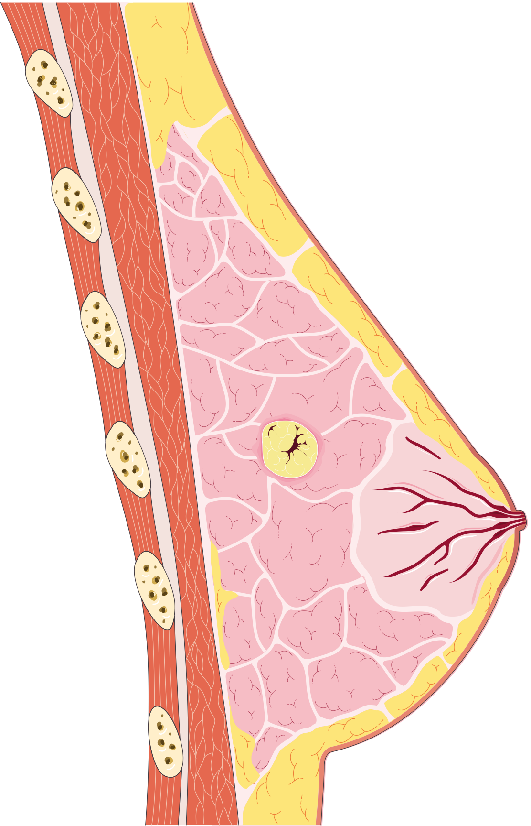


We can imagine an abstract idea of a tumor growing within tissue.
The key is to ask how it occurs.

Slide 3


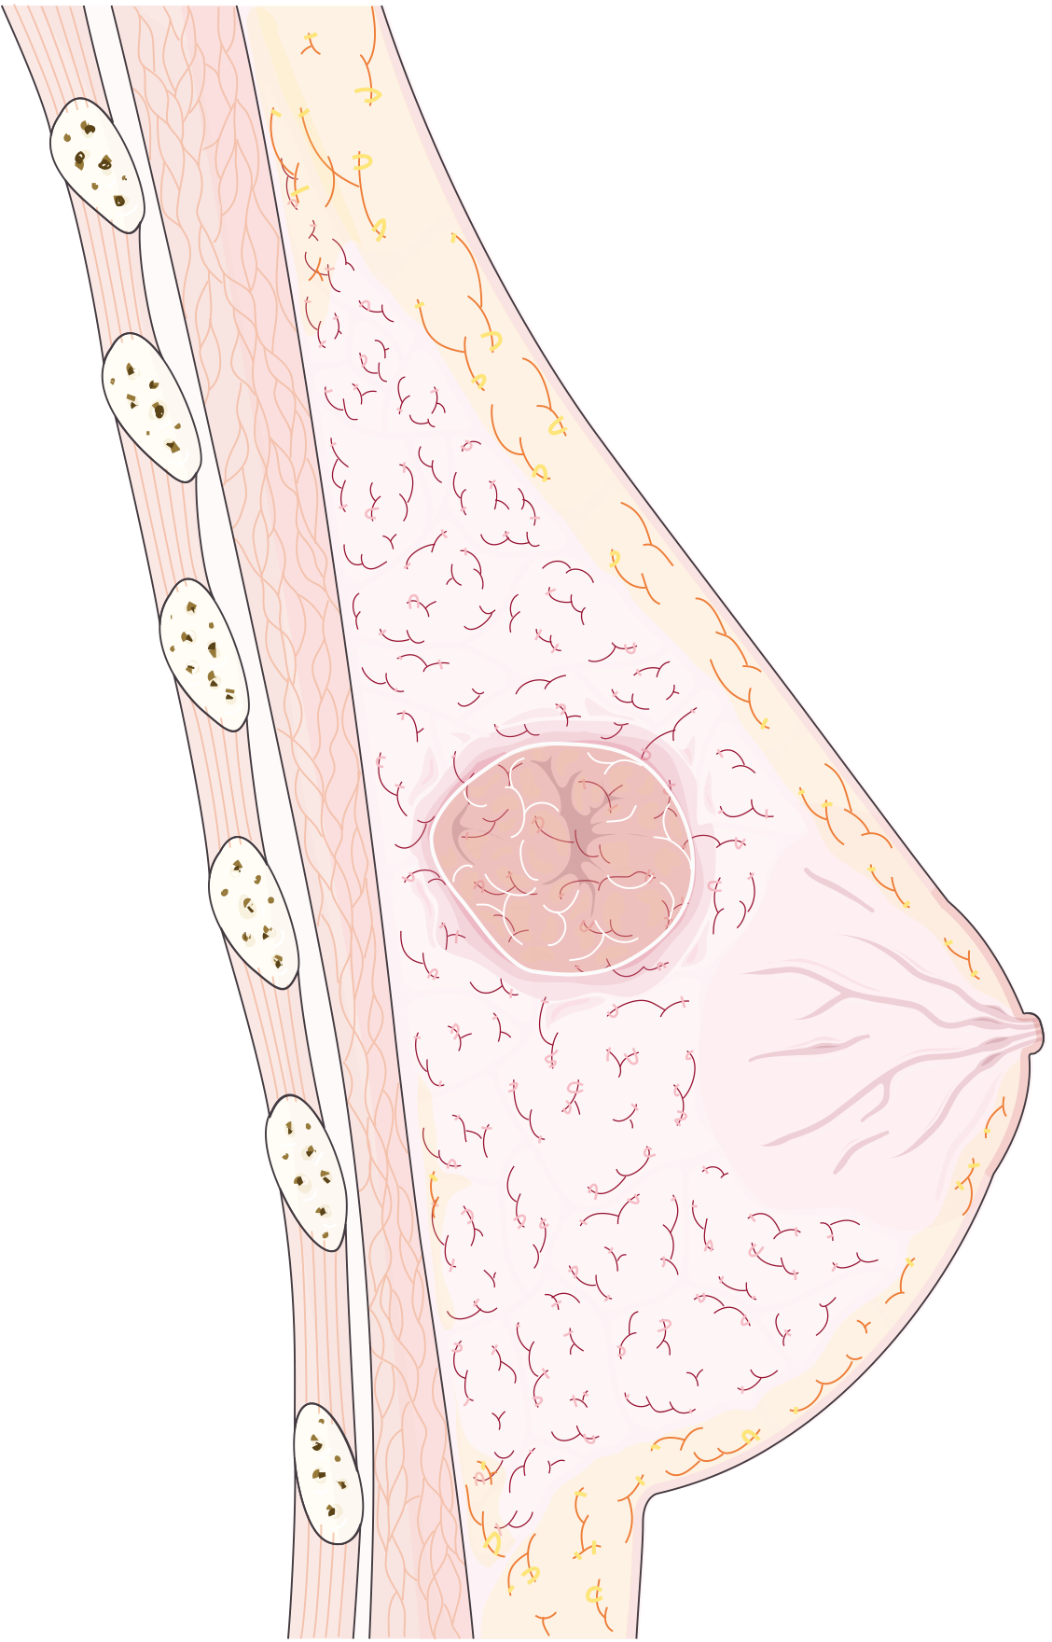
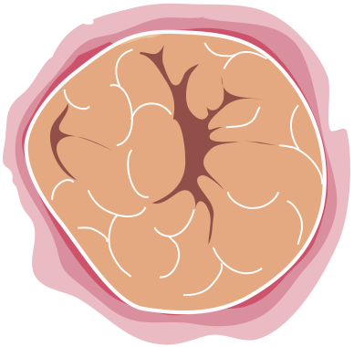
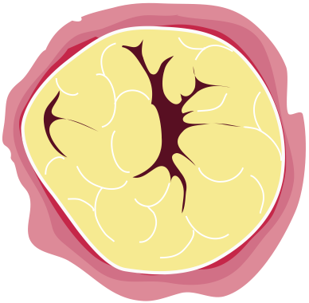
Every cell must live and grow according to its genetic and environmental constraints.
Any cell has the potential to either respond too little or too much.
We wish to find the underlying cause.

Slide 4
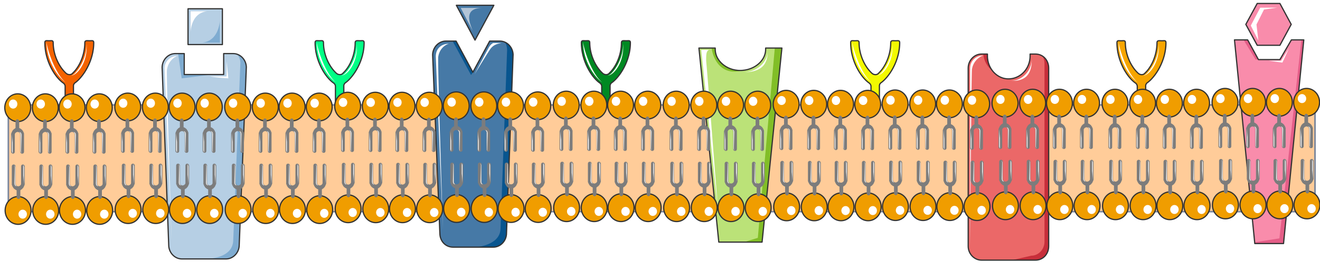
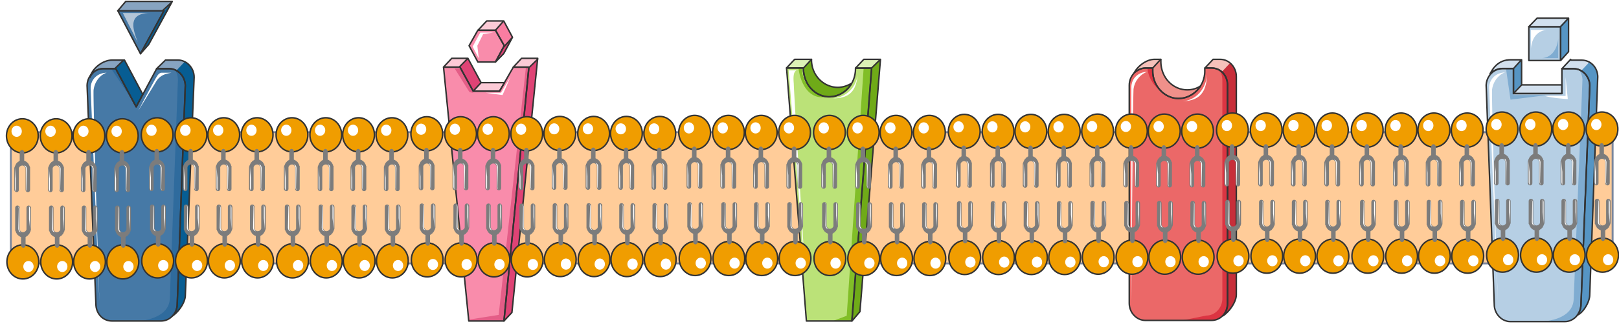
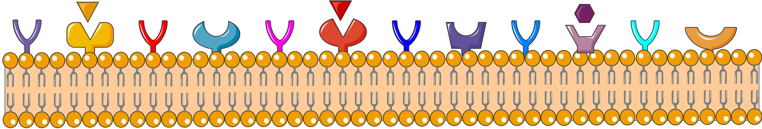
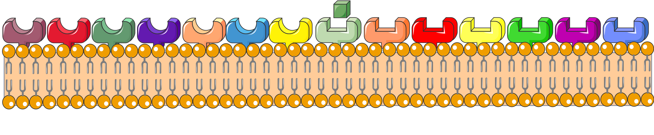
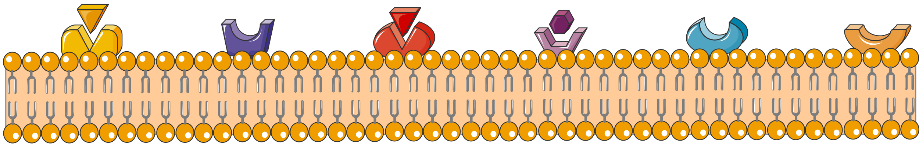
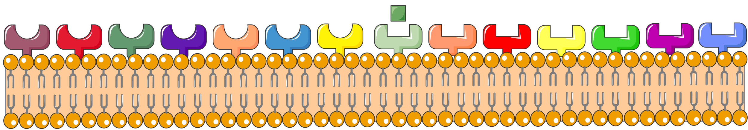
Every cells consists of hundreds of surface-embedded proteins.

Slide 5
Stimulation of these surface receptors propagates a chain reaction
into the cell, to evoke a response

Slide 6
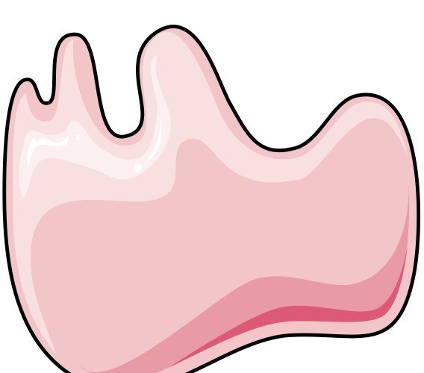




















There are countless ways that the signal is transmitted
Each pathway has unique characteristics
Although, to know one is to know all

Slide 7
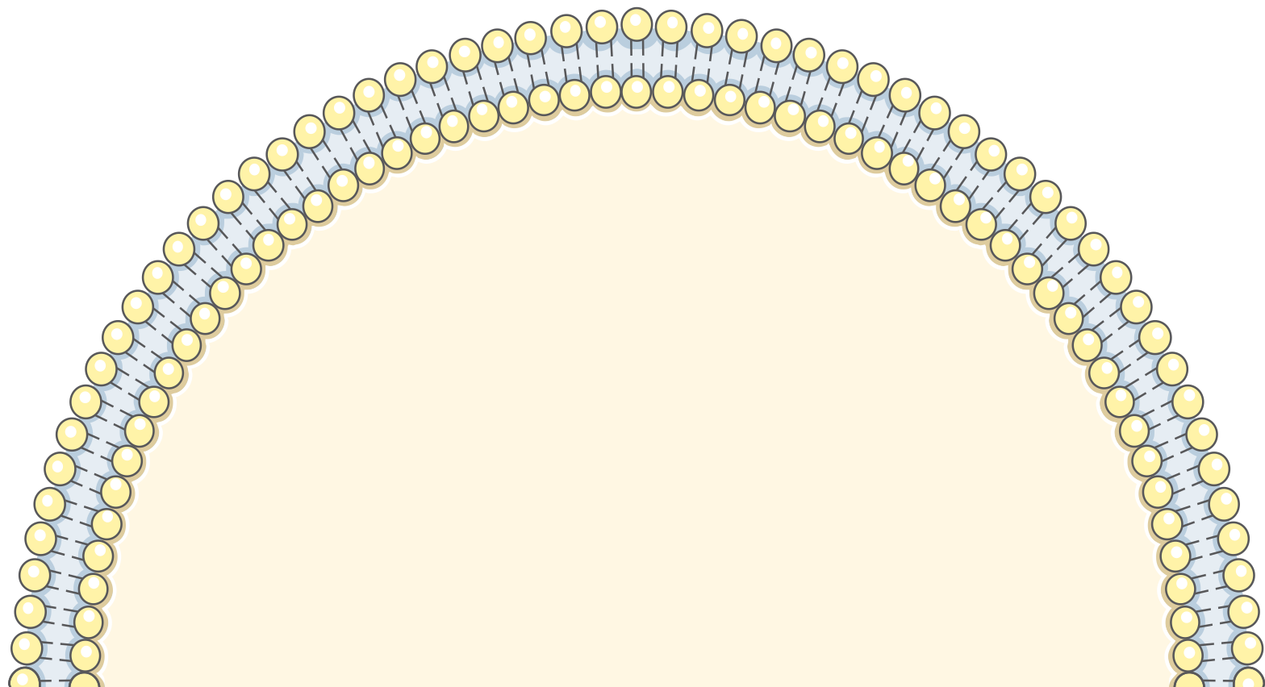
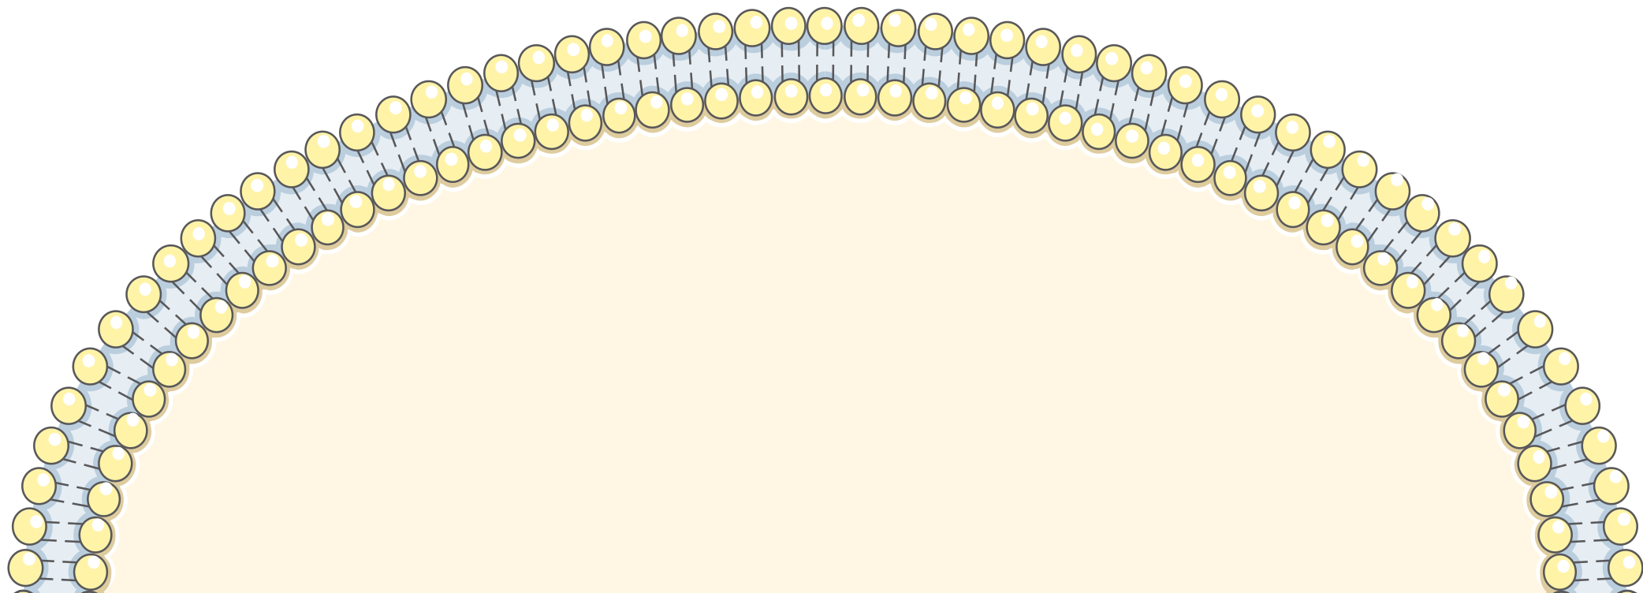
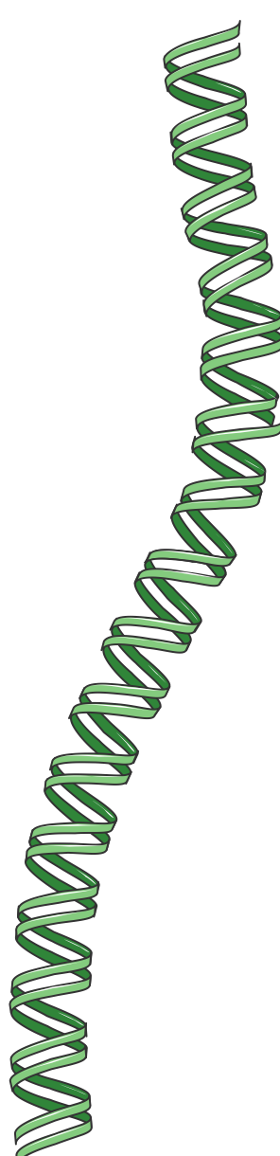
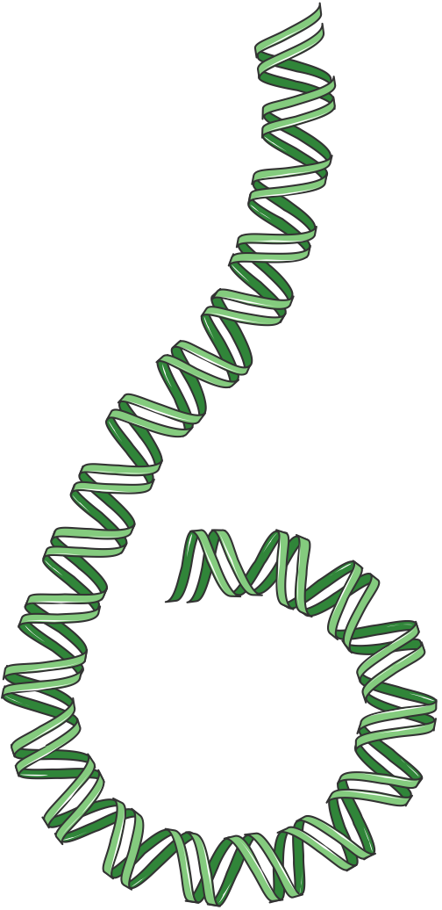
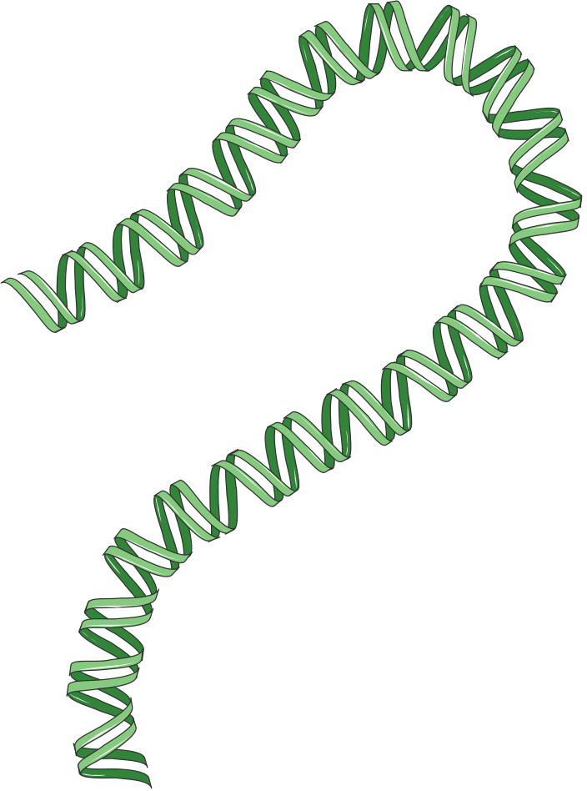
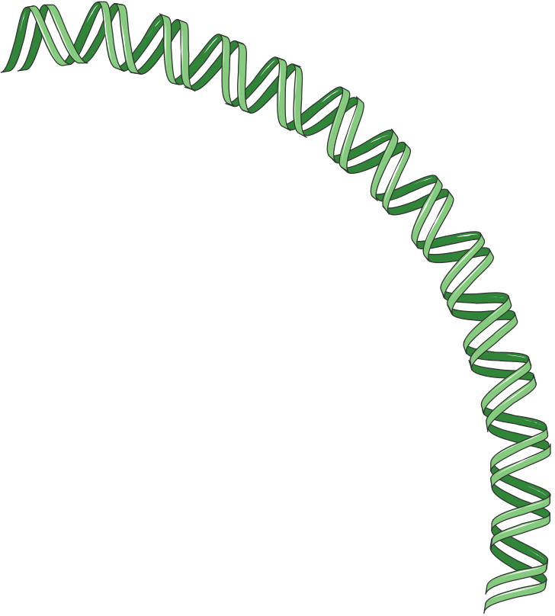
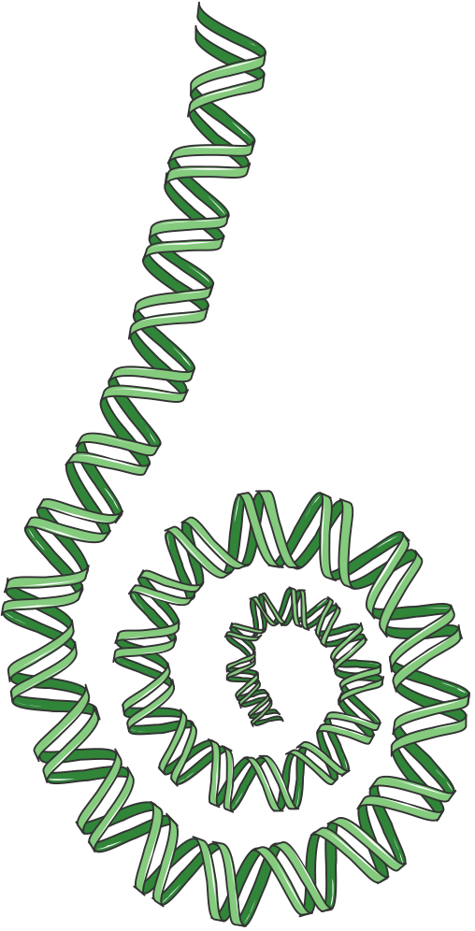
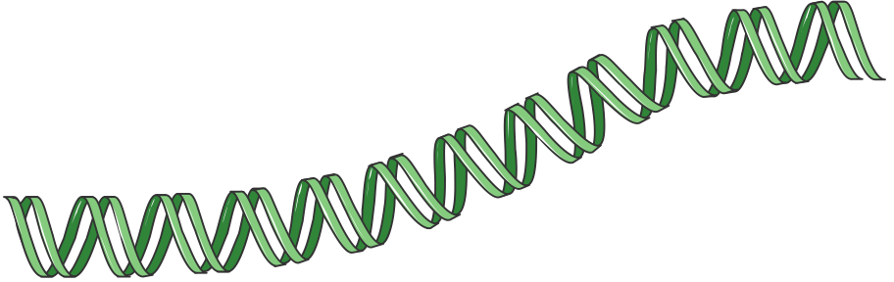
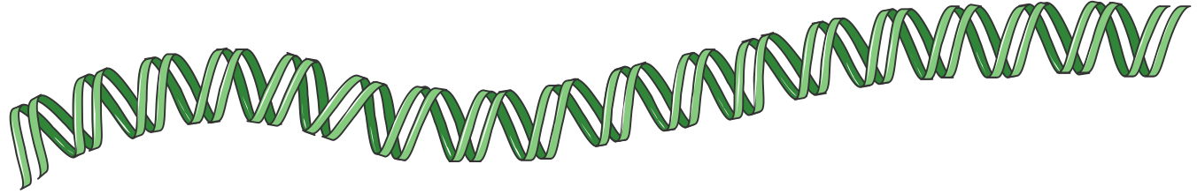

Whatever the process, a signal may ultimately result in the stimulation or repression of genes related to this pathway

Slide 8
Whatever the process, a signal may ultimately result in the stimulation or repression of genes related to this pathway

Slide 9
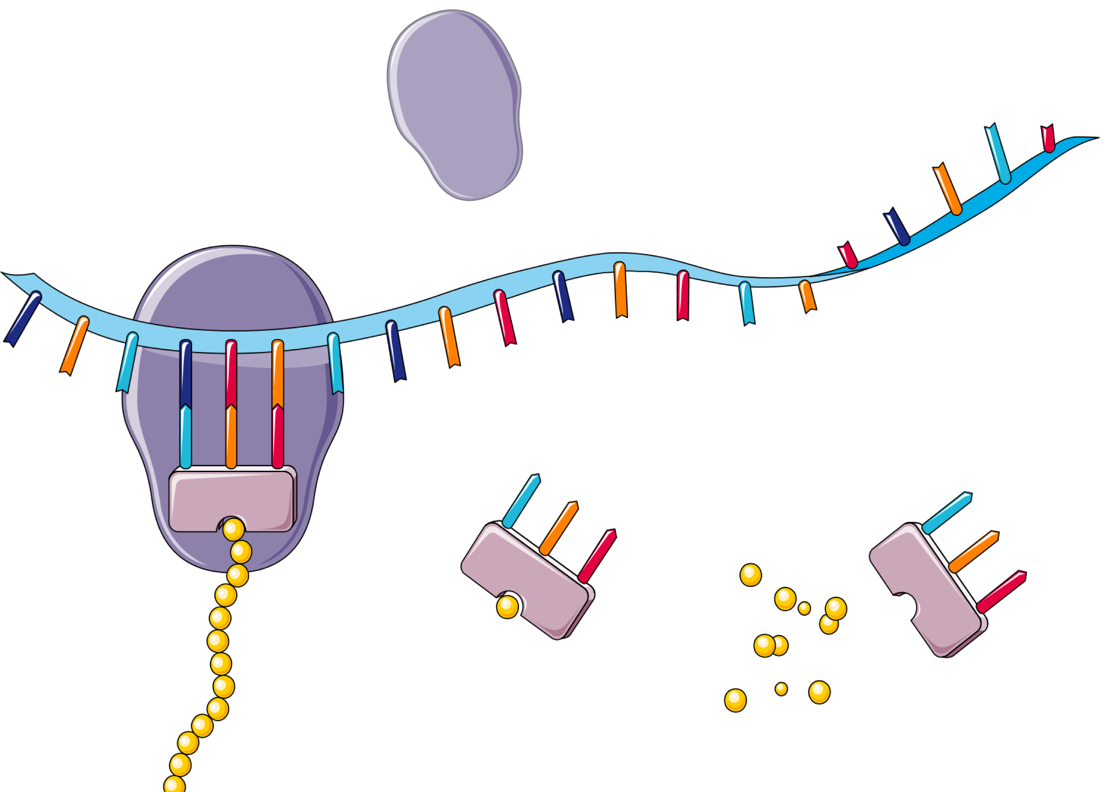
“Stimulated genes” result in translation into mRNA
And thus into protein.

Slide 10
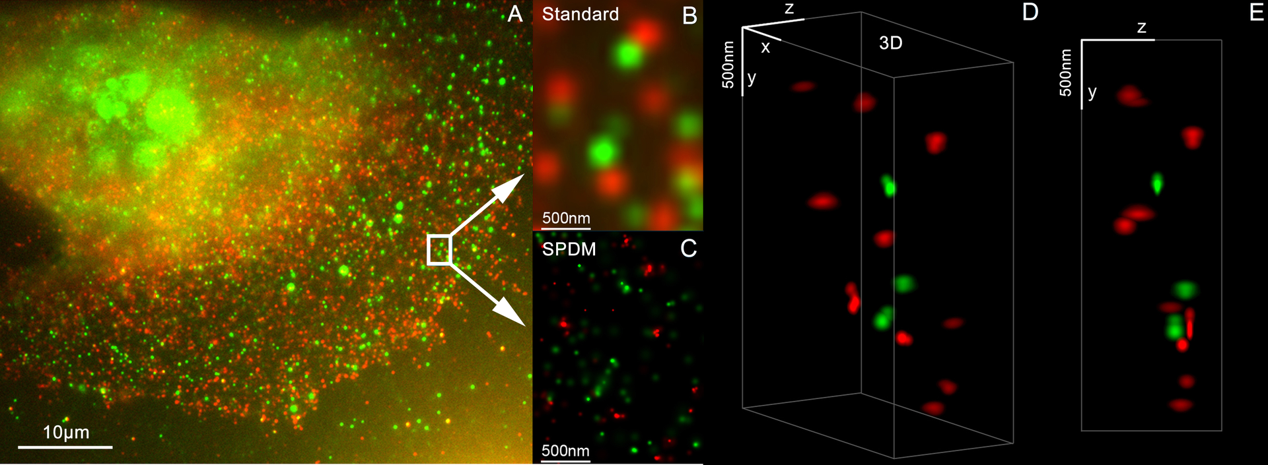
Her2 and Her3 distribution on a breast cell, (3D Dual Colour Super Resolution Microscopy SPDMphymod / LIMON, marked with Alexa 488 and 568). Andy Nestl CC BY-SA 3.0.

Slide 11
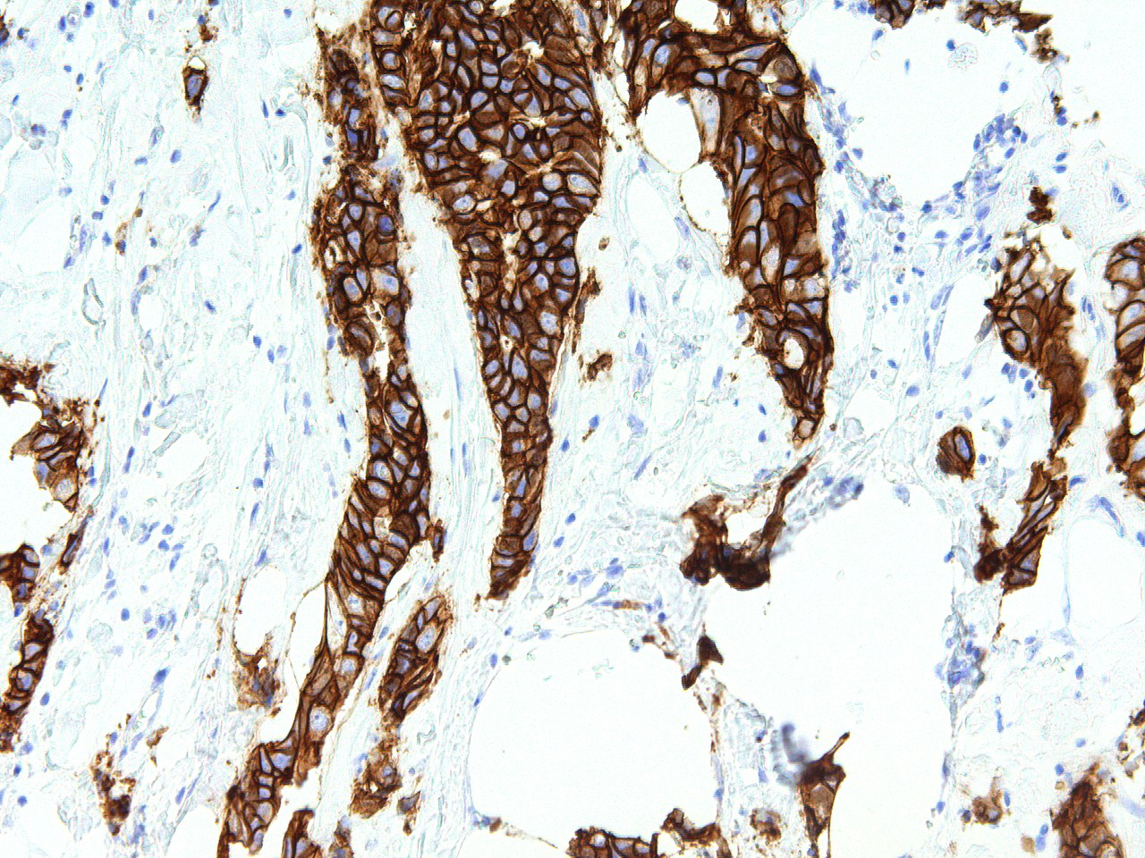
Her 2 staining on patient breast cancer tissue identified as stage 3.
GenomeMe Lab Inc. - http://www.genomeme.ca/molecular-pathology/Her2-Neu.html
CC BY 4.0

Slide 12
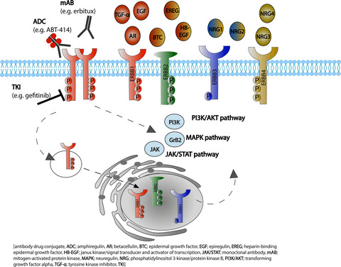
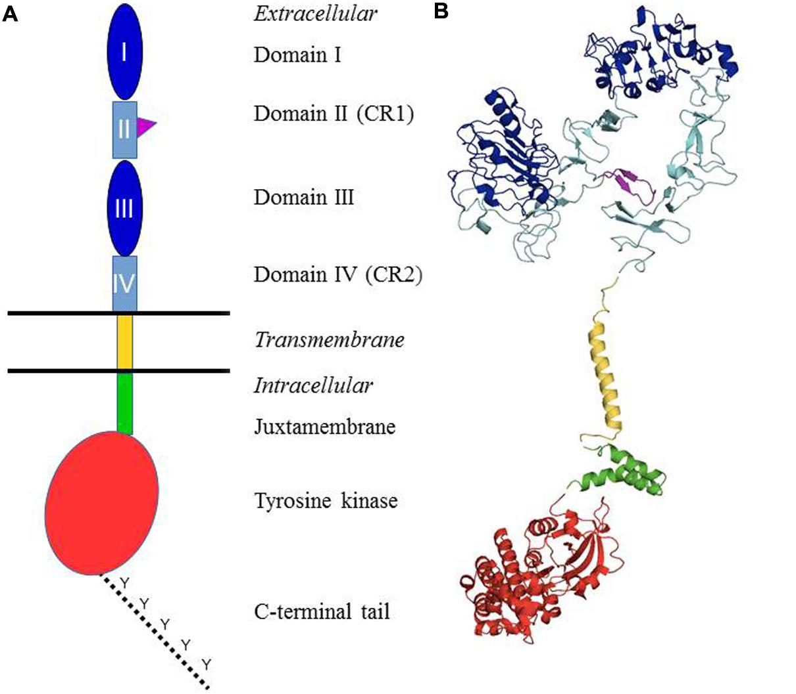
Appert-Collin, et. al. Role of ErbB Receptors in Cancer Cell Migration and Invasion. Front. Pharmacol., 24 November 2015 Sec. Pharmacology of Anti-Cancer Drugs https://doi.org/10.3389/fphar.2015.00283
FIGURE 1. Structural organization of the ErbB/HER receptors. (A) Shows a schematic representation of the different domains. The extracellular part of the receptors is composed of four domains: I and III = ligand-binding domain (dark blue); II and IV = cysteine-rich domains (light blue). The domain II contains the dimerization arm (purple). It is followed by the single transmembrane domain (yellow), a juxtamembrane domain (green), the tyrosine kinase domain (red) and a C-terminal tail which contains the main tyrosines that are phosphorylated upon receptor activation (dotted line). (B)Presents the structures of different domains of the human EGFR which have been established through X-ray crystallography or solution RMN. Color coding is identical to (A). Protein Data Bank (PDB) accession codes are as follows: ectodomain (in closed unliganded conformation), 3QWQ, transmembrane region, 2KS1, juxtamembrane domain, 1Z9I; kinase domain, 3W32. No structure is available for the C-terminal tail.
von Achenbach, C., Weller, M. and Szabo, E. (2018), Epidermal growth factor receptor and ligand family expression and activity in glioblastoma. J. Neurochem., 147: 99-109. https://doi.org/10.1111/jnc.14538

